Slide 1
NAME: PUTTUL KUMARI ROLL NO: 88 COMPANY NAME: UST GLOBAL
LIBRARY MANAGEMENT SYSTEM

Slide 2
Problem Statement
This study will support and manage library transactions and services and also , the computer technology students will be able to develop a system program using visual studio and spring rest software for a design of library monitoring system in response to the problems in the current manual library operation, services and transaction.

Slide 3
Technology and Tools
Software name:
Here we are using front-end and back-end both
Angular7
Port number: 4200
Tool :Apache-tomcat-8.5.47
JAVA using Spring Rest
Port number:8080
Tool: EclipseJee 2019-09

Slide 4
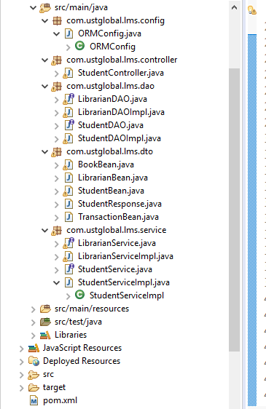
Architecture

Slide 5
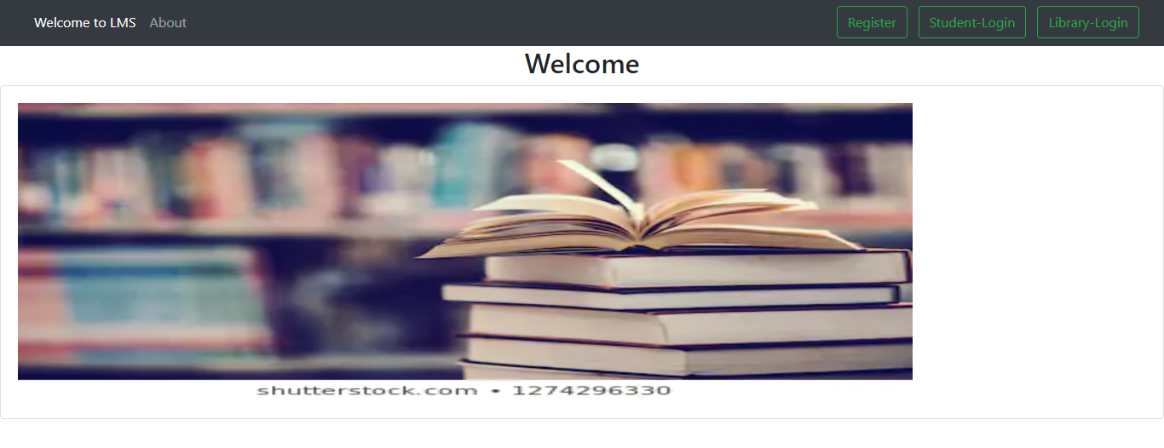

Slide 6
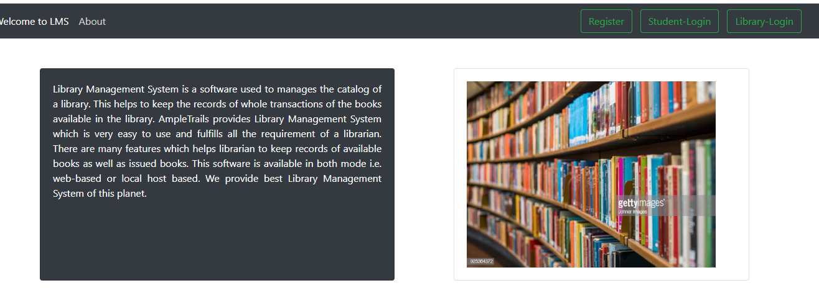
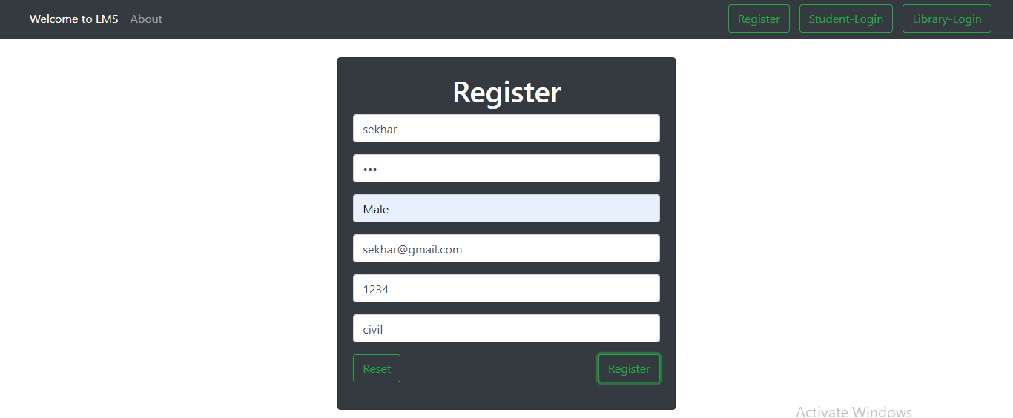

Slide 7
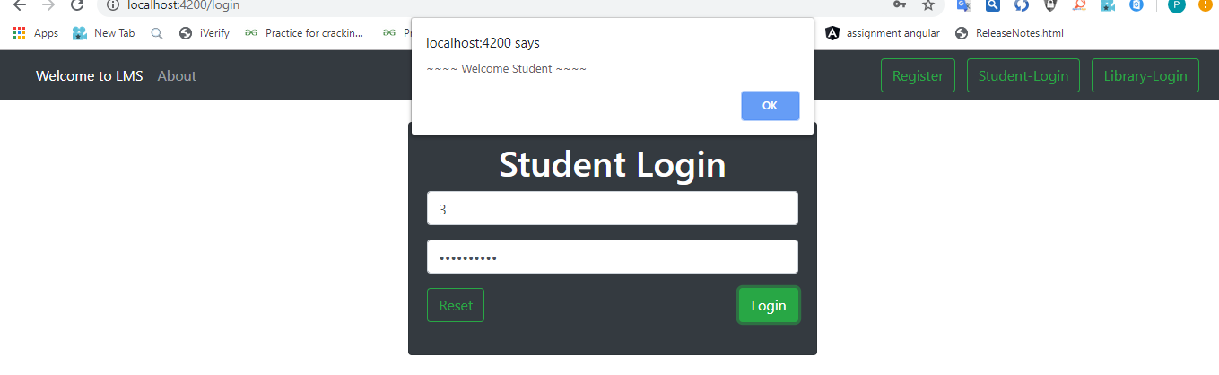
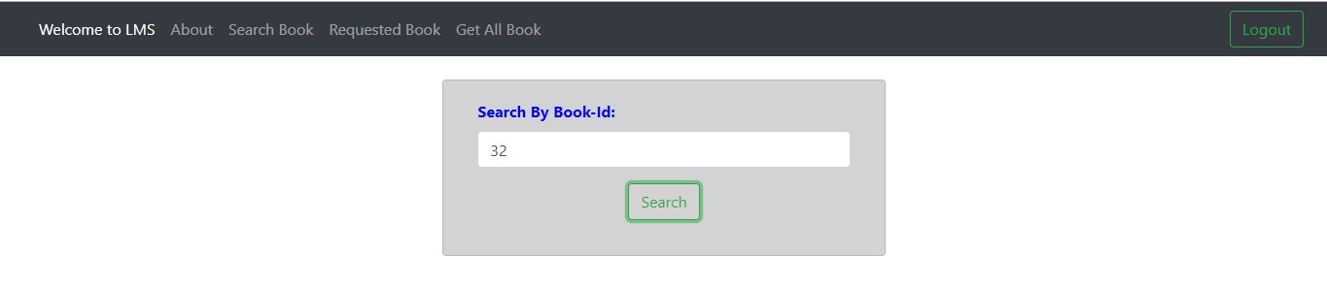

Slide 8
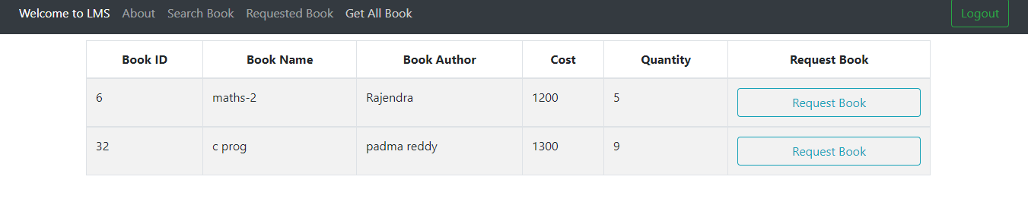
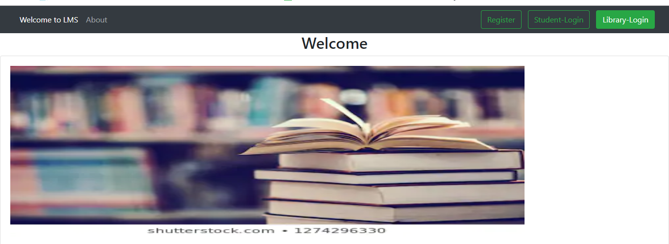

Slide 9
Flow chart
Start
Admin
Student
Login
Login
Add Book
Issue Book
Search Book
Request Book
Return Book
Update book
Return Book
Update
Logout
Stop

Slide 10
Modules
In this project, We have following modules-
Admin Module
Student Module
Librarian Module

Slide 11
Conclusion
This website provides a computerized version of library management system which will benefit the students as well as the staff of the library.
It makes entire process online where student can search books, staff can generate reports and do book transactions.
It also has a facility for student login where student can login and can see status of books issued as well request for book or give some suggestions.

Slide 12
Future Enhancement
There is a future scope of this facility that many more features such as online lectures video tutorials can be added by teachers as well as online assignments submission facility , a feature Of group chat where students can discuss various issues of engineering can be added to this project thus making it more interactive more user friendly and project which fulfills each users need in the best way possible

Slide 13


